Slide 1
Introducing a new era in the management of XLH¹
ANZBMS-MEPSA-ANZORS 2022
Kyowa Kirin Australia Lunchtime Symposium
Wednesday 3rd August
Reference: 1. Collins, J. Journal of Bone and Mineral Research, 2018;23(8):1381–1382

Slide 2
DISCLAIMER
“The information contained herein is confidential and privileged and for the information of the intended recipient(s) only. Any unauthorised use, including but not limited to any disclosure, publication or distribution, is strictly prohibited. Information about pharmaceutical products (including but not limited to products currently in development) contained herein is not intended to constitute medical advice. This presentation may contain preliminary proposals, plans, strategies, statements, assumptions and/or opinions, which do not represent final positions, facts or guarantees of future performance, but are drafts, work-in-progress and forward-looking statements only. Kyowa Kirin Australia Pty Ltd makes no representations and gives no warranties of any nature in respect of any information contained herein, including but not limited to the accuracy or completeness of any information, facts and/or opinions. Kyowa Kirin Australia Pty Ltd and its associated companies do not accept liability for the use of and reliance on any information contained herein."

Slide 3
General speaker disclaimer
The content presented by each speaker is their own work and has not been influenced by employees of Kyowa Kirin Australia.
Speakers have received an honorarium for the preparation and presentation of their work.
Kyowa Kirin Australia does not expect payment for services to be an inducement for the Speaker to prescribe, supply, administer, recommend, purchase, pay for, reimburse, authorise, approve, sell or supply any product or services of the Company and the Speaker agrees that this this honorarium does not constitute an illegal inducement of any kind.

Slide 4
Agenda
Time | Topic | Speaker/Chair
Topic 1: Welcome | Welcome
1:40pm | Welcome from the sponsor | Dr Tiffany BAMFORD KKAU Medical Affairs
1:43pm | Introductions & learning objectives from the Chair | Prof Peter EBELING (Chair) Monash Health
Topic 2: X-Linked Hypophosphataemia | Sales onboarding
1:45pm | XLH: Looking back, looking forward | Prof Craig MUNNS (Speaker) Queensland Health
Topic 3: Introducing CRYSVITA® (burosumab) - a new treatment option for XLH | Medical update
1:50pm | The safety and efficacy of CRYSVITA® in paediatrics | Prof Craig MUNNS (Speaker)
1:58p | The safety and efficacy of CRYSVITA® in adults | Dr Syndia LAZARUS (Speaker) Queensland Health
2:06pm | Panel Discussion The practical use of CRYSVITA® in Australia | Prof Peter EBELING (Chair) Prof Craig MUNNS (Panellist) Dr Syndia LAZARUS (Panellist)
2:18pm | Close | Prof Peter EBELING

Slide 5
Disclosures
Dr Tiffany Bamford
I am an employee of Kyowa Kirin Australia

Slide 6
Welcome
Kyowa Kirin Australia is a proud sponsor of
ANZBMS-MEPSA-ANZORS 2022
Welcome to:
Introducing a new era in the management of XLH¹
Reference: 1. Collins, J. Journal of Bone and Mineral Research, 2018;23(8):1381–1382
Notes:
Welcome attendees and thank them for coming
Photos and filming reminder
Introduce Chair

Slide 7
Introducing the Chair
Professor Peter Ebeling, OA
Head of the Department of Medicine, School of Clinical Sciences at Monash Health, Faculty of Medicine, Nursing and Health Sciences, Monash University.

Slide 8
FGF23 – a complex hormone involved in multiple disorders
Professor Peter R Ebeling AO
Department of Medicine
School of Clinical Sciences
Melbourne, Australia
3 August 2022

Slide 9
Disclosures
Departmental research funding from Alexion, Sanofi and Amgen
Honoraria from Amgen
Honoraria from Kyowa Kirin Australia

Slide 10
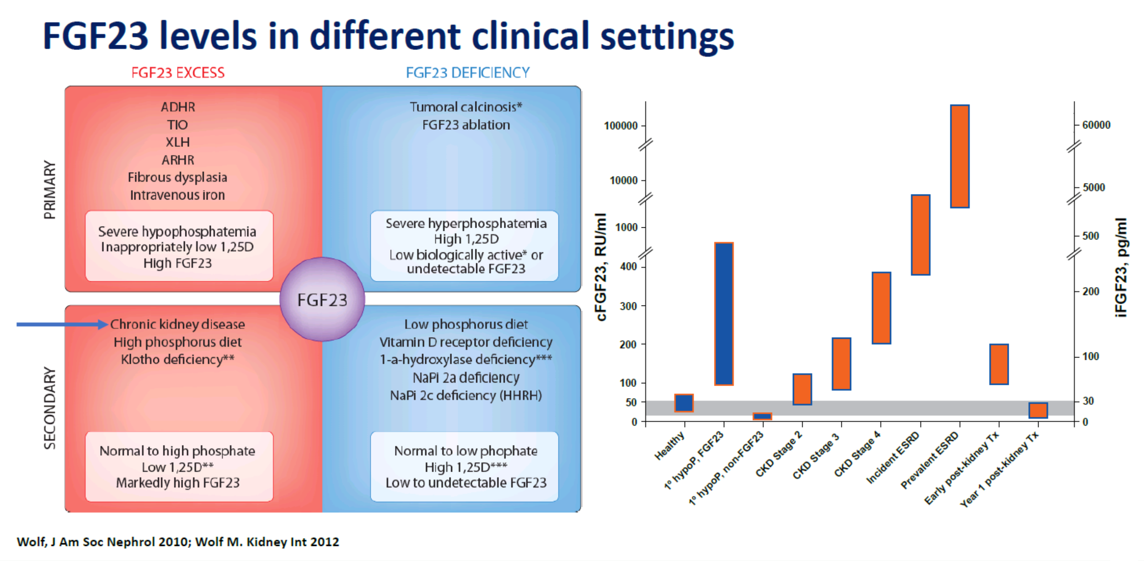
Elevated FGF-23 Levels May Be Primary or Secondary

Slide 11
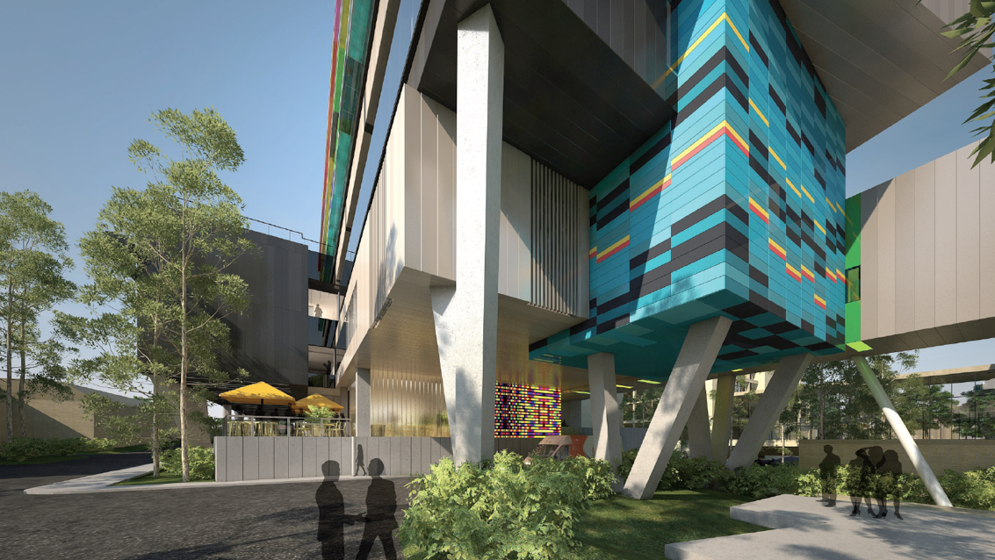
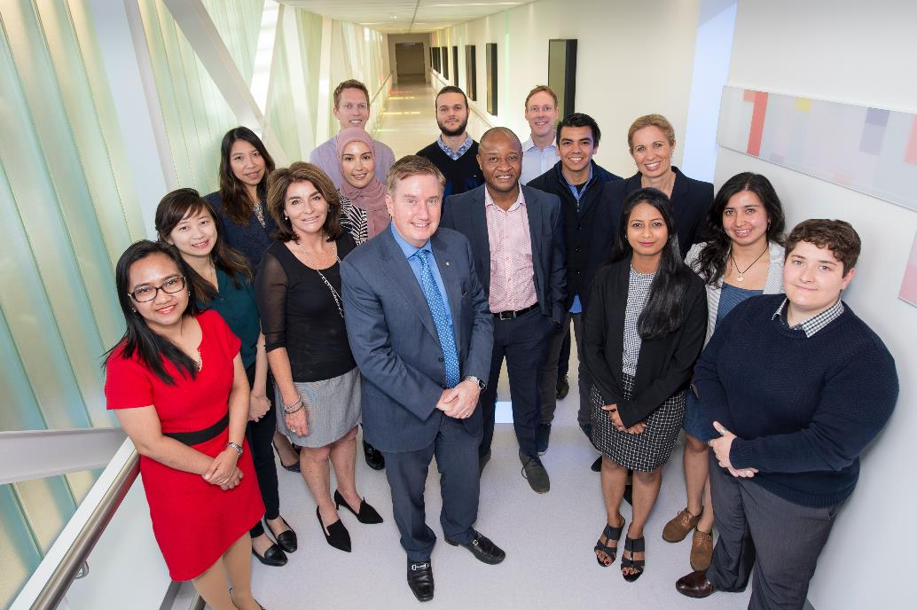
Thank You!
Acknowledgements

Slide 12
Agenda
Time | Topic | Speaker/Chair
Topic 1: Welcome | Welcome
1:40pm | Welcome from the sponsor | Dr Tiffany BAMFORD KKAU Medical Affairs
1:43pm | Introductions & learning objectives from the Chair | Prof Peter EBELING (Chair) Monash Health
Topic 2: X-Linked Hypophosphataemia | Sales onboarding
1:45pm | XLH: Looking back, looking forward | Prof Craig MUNNS (Speaker) Queensland Health
Topic 3: Introducing CRYSVITA® (burosumab) - a new treatment option for XLH | Medical update
1:50pm | The safety and efficacy of CRYSVITA® in paediatrics | Prof Craig MUNNS (Speaker)
1:58p | The safety and efficacy of CRYSVITA® in adults | Dr Syndia LAZARUS (Speaker) Queensland Health
2:06pm | Panel Discussion The practical use of CRYSVITA® in Australia | Prof Peter EBELING (Chair) Prof Craig MUNNS (Panellist) Dr Syndia LAZARUS (Panellist)
2:18pm | Close | Prof Peter EBELING

Slide 13
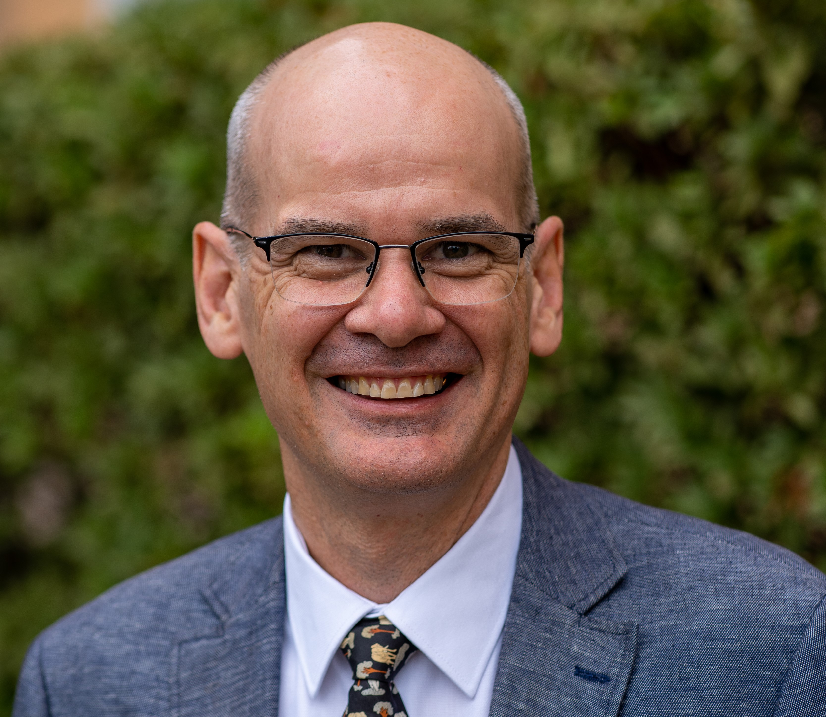
Introducing…
Professor Craig Munns
Head, Mayne Academy of Paediatrics;
Director, Child Health Research Centre, The University of Queensland;
Senior Medical Officer,
Department of Endocrinology at Queensland Children’s Hospital

Slide 14

XLH: Looking Back, Looking Forward
Prof Craig Munns
Head, Mayne Academy of Paediatrics
Director, Child Health Research Centre
Paediatric Endocrinologist, QCH

Slide 15
General speaker disclaimer
The content presented by each speaker is their own work and has not been influenced by employees of Kyowa Kirin Australia.
Speakers have received an honorarium for the preparation and presentation of their work.
Kyowa Kirin Australia does not expect payment for services to be an inducement for the Speaker to prescribe, supply, administer, recommend, purchase, pay for, reimburse, authorise, approve, sell or supply any product or services of the Company and the Speaker agrees that this this honorarium does not constitute an illegal inducement of any kind.

Slide 16
Disclosures
Research funding
  Kyowa Kirin International, Plc.
  Ultragenyx Pharmaceutical, Inc.
Consultant
  Kyowa Kirin International, Plc.

Slide 17
Outline
XLH: Looking Back, Looking Forward
History of X-linked Hypophosphataemia
CRYSVITA® (FGF23 antibody)
Gene therapy
The Safety and Efficacy of CRYSVITA® in Paediatrics
Case of X-linked Hypophosphataemic Rickets
Phase 3 study in children
Extension study

Slide 18
X-Linked Hypophosphataemia
Most common genetic hypophosphataemia – 1:20,000-25,000
X-linked dominant
Frequently sporadic
Inactivating mutations in PHEX
Biochemistry:
  Low serum phosphate
  Elevated Alkaline Phosphatase
  Reduced TMP/GFR (tubular threshold maximum for phosphate)
  Normal (mild elevation) Parathyroid Hormone
  Normal serum calcium
  Normal 25 Hydroxy Vitamin D
  Low - normal 1-25(OH)₂D
  Elevated or Inappropriately Normal FGF23
Hyp Consortium, Nat Genet, 1995;11.
Imel et al, JBMR Plus, 2019;Aug.

Slide 19
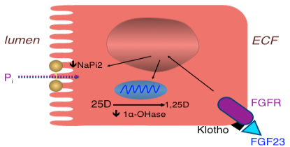
PHEX, FGF23 and XLH : mechanism of action
PHEX mutation leads to excessive FGF23
  ↓ Renal tubular phosphate reabsorption (decreased NaPi2)
  ↓ Activation of 1,25(OH)₂D (decreased 1α-OHase)
  ↓ Serum phosphate
Imel et al, ICE/ENDO 2014.
Renal Tubular Cell
19

Slide 20
Clinical Features of XLH
UQ CHRC
ANZBMS 2022
Sparre Beck-Nielsen et al Orphanet J Rare Dis 2019
Notes:
Fig. 7 FGF23 and cranial abnormalities. Over-expression of FGF23 leads to up-regulation of FGFR2/3 signalling. Cross-binding of FGF23 with
FGFR2/3 at cranial sutures, impaired endochondral ossification of the skull, and osteomalacia-induced malformation of the base plate can all lead
to craniosynostosis

Slide 21
Clinical Features of XLH
UQ CHRC
ANZBMS 2022
Sparre Beck-Nielsen et al Orphanet J Rare Dis 2019
Notes:
Fig. 7 FGF23 and cranial abnormalities. Over-expression of FGF23 leads to up-regulation of FGFR2/3 signalling. Cross-binding of FGF23 with
FGFR2/3 at cranial sutures, impaired endochondral ossification of the skull, and osteomalacia-induced malformation of the base plate can all lead
to craniosynostosis

Slide 22
Clinical Features of XLH
UQ CHRC
ANZBMS 2022
Sparre Beck-Nielsen et al Orphanet J Rare Dis 2019
Notes:
Fig. 7 FGF23 and cranial abnormalities. Over-expression of FGF23 leads to up-regulation of FGFR2/3 signalling. Cross-binding of FGF23 with
FGFR2/3 at cranial sutures, impaired endochondral ossification of the skull, and osteomalacia-induced malformation of the base plate can all lead
to craniosynostosis

Slide 23
X-linked Hypophosphataemia (XLH)
1930
1940
1950
1960
1970
1980
1990
2000
2010
2020
1937 Rickets in infancy resistant to
high-dose vitamin D (Albright)
1958 X-link dominance inheritance
1974 Hypophosphatemia persists
after renal transplantation
1995 PHEX mutations cause XLH
1998 PHEX mutations cause adult-onset
vitamin D-resistant osteomalacia
2000 FGF23 mutations cause ADHR
2002 High FGF23 levels in XLH
Slide Courtesy of Dieter Haffner & Francesco Emma

Slide 24
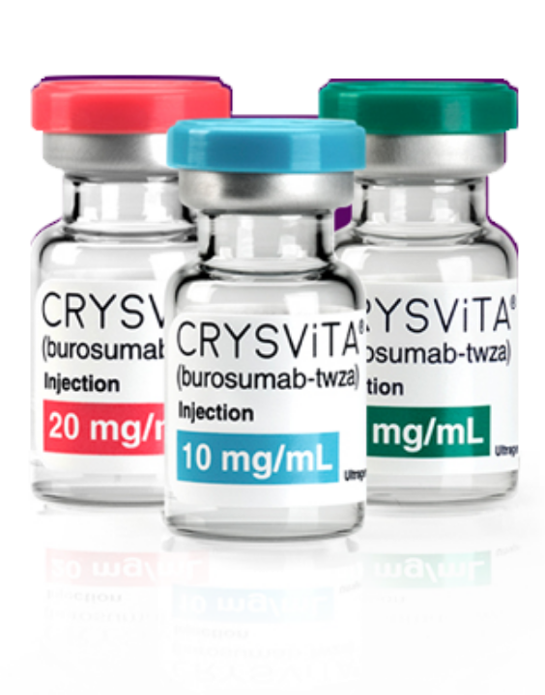
X-linked Hypophosphataemia (XLH)
1930
1940
1950
1960
1970
1980
1990
2000
2010
2020
1937 Rickets in infancy resistant to
high-dose vitamin D (Albright)
1958 X-link dominance inheritance
1974 Hypophosphatemia persists
after renal transplantation
1995 PHEX mutations cause XLH
1998 PHEX mutations cause adult-onset
vitamin D-resistant osteomalacia
2000 FGF23 mutations cause ADHR
2002 High FGF23 levels in XLH
2009 anti-FGF23 antibodies in Hyp mouse
2014 First clinical trial with burosumab
Recombinant human IgG1 monoclonal antibody
that binds to FGF23 and inhibits FGF23 biologic activity
2018 FDA & EMA approval of burosumab
2022 PBAC recommendation of burosumab

Slide 25
Gene Therapy in XLH
Liver-targeting AAV vector to inhibit FGF23 signalling.
Hepatic expression of the C-terminal tail of FGF23 partially corrected skeletal manifestations, growth and osteomalacia in a XLH mouse model.
Zhukouskaya et al, Sci. Adv. 2021;7.
AAV-8 combined with Col2.3 and Sp7 promoters
can selectively transduce osteoblasts
within bone via systemic injection
Courtesy of Aaron Schindeler
ANZBMS 2022

Slide 26
The Safety and Efficacy of
CRYSVITA® in Paediatrics
Prof Craig Munns
Head, Mayne Academy of Paediatrics
Director, Child Health Research Centre
Paediatric Endocrinologist, QCH

Slide 27
Phase 3 Study of Burosumab in Children
Imel et al. Lancet 2019;393:2416-2427
Padidela et al. Calcified Tissue International 2021;108:622-633

Slide 28
Case of X-linked Hypophosphataemic Rickets
7month old boy
Presented with lower limb bowing
Born at 39 weeks, elective caesarean section
First child of non-consanguineous Anglo-Australian parents
Normal development
Length 64.5cm (10th-25th),Weight 7.5kg (25th-50th)
Frontal bossing, rachitic rosary, flaring wrists
Systemic exam otherwise unremarkable
No family history of bone or growth disorder

Slide 29
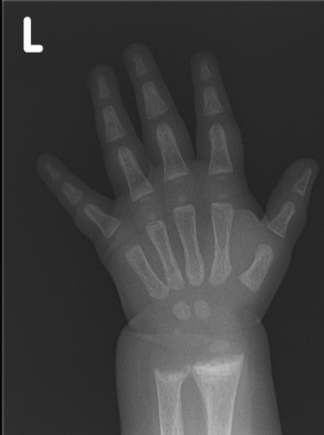
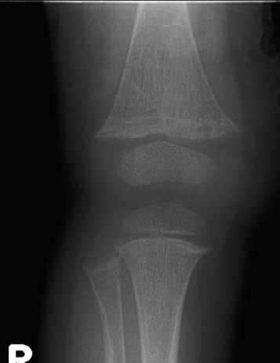
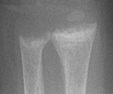
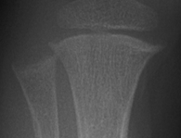
X-Ray
Rickets

Slide 30
Investigations
Calcium 2.31 mmol/L (2.10-2.65)
Magnesium 0.94 mmol/L (0.71-0.96)
Phosphorus 0.70 mmol/L (1.20-2.10)
Alk-phos 586 u/l (140-360)
PTH 6.2 pmol/L (1-7)
25-(OH)vit D 57nmol/L (31-107)
PHEX: c.[151C>T];[=] p.[(Gln51*)]; Pathogenic variant - premature stop codon

Slide 31
Treatment
Doses (start low and build up to avoid GIT intolerance)
    Phosphate 20 mg/kg/day
    Calcitriol 20 ng/kg/day
Phosphate sandoz 750 mg/day (5 divided doses)
Calcitriol 250 ng bd

Slide 32
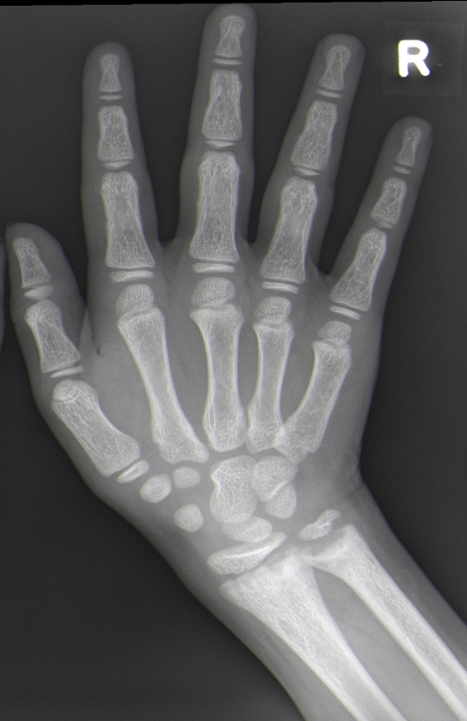
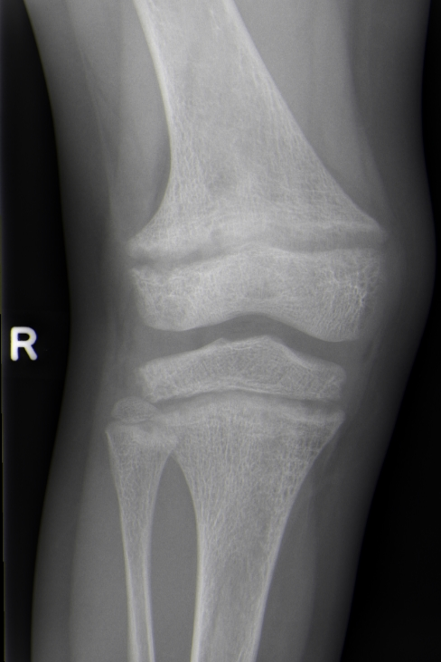
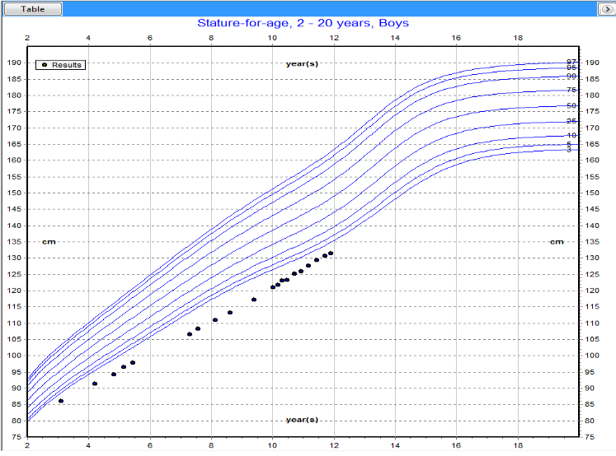
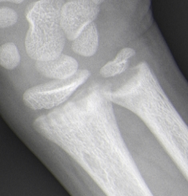
Phosphate 750 mg/day in 4 divided doses
Calcitriol 0.25mcg twice daily
10 years of age
Burosumab
Pi 0.87 mmol/L (1.1-1.9)
ALP 619 U/L (120-440)
PTH 4.3 pmol/L (1-7)
No nephrocalcinosis
Genu valgum
Aches and pains
Short stature
Recurrent tooth abscess

Slide 33
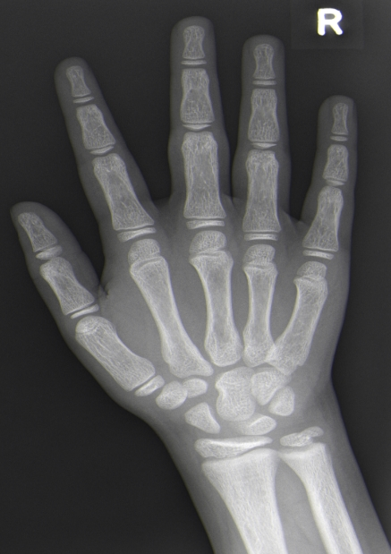
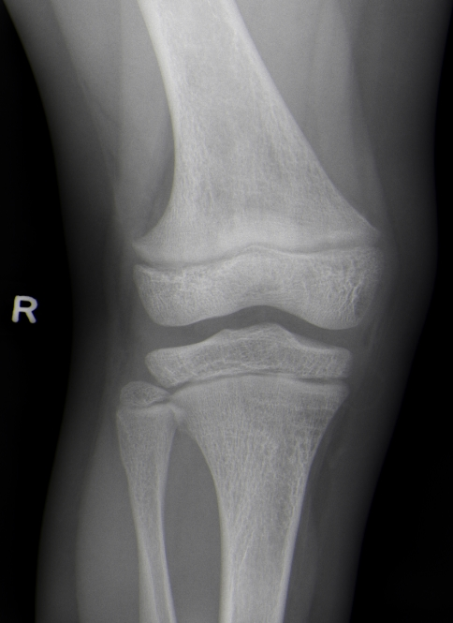
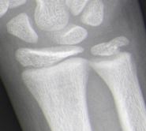
11.5 years of age
Burosumab 0.8 mg/kg second weekly
Cholecalciferol 400 IU daily
Burosumab
Pi 1.2 mmol/L (1.1-1.9)
ALP 400 U/L (120-440)
PTH 2.3 pmol/L (1-7)
No nephrocalcinosis
Genu valgum improved
No limb pain - running
Improved growth velocity
4.9 cm/yr to 5.6 cm/yr
No tooth abscess

Slide 34
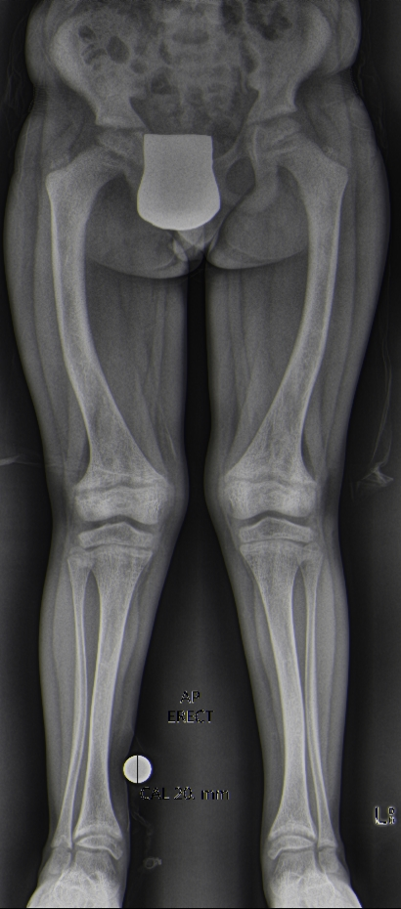
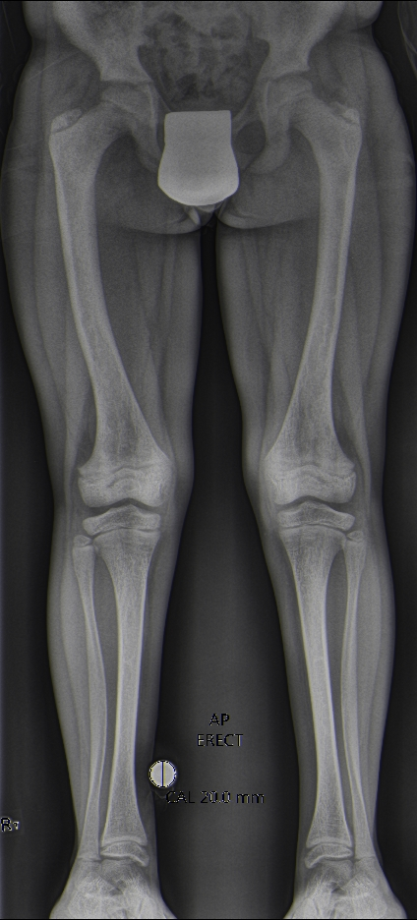
Genu valgum improvement over 18 months Burosumab
10 y/o
11.5 y/o

Slide 35
Phase 3 Study Design & Disposition
Population
Children with XLH
1-12 years old
Total RSS ≥2.0
Serum Pi < 1.0 mmol/L
Prior oral phos./vit. D (for ≥12 or ≥6 consecutive months for ages ≥ or < 3 years old)
Screening (N=122),
7-day SOC washout,
1:1 Randomization (N=61)
Stratified by
Age (<5 vs ≥5 yrs)
RSS (≤ 2.5 vs >2.5)
Region (Japan vs ROW)
0.8 mg/kg SC
burosumab Q2W
n=29
oral phosphate/
active vitamin D (Pi/D)
n=32
Week
0
40
64
Primary Efficacy & Safety Analysis
Additional Efficacy* & Safety Analysis
All 61 subjects completed 64 Weeks and are included in the safety & efficacy analysis
* Primary assessments of height Z-score and RGI-C lower limb deformity score are at Week 64
EOS, end of study; SOC, standard of care; ROW, rest of world
Imel et al. Lancet 2019;393:2416-2427

Slide 36
Demographics and Baseline Characteristics
Characteristic | Pi/D (n=32) | Burosumab (n=29)
Age, years, mean (SD) | 6.3 (3.2) | 5.8 (3.4)
Male, n (%) | 14 (43.8) | 13 (44.8)
White, n (%) | 25 (78.1) | 25 (86.2)
Height Z-score, mean (SD) median [range] | -2.1 (0.9) -2.1 [-4.7, -0.1] | -2.3 (1.2) -2.3 [-5.0, -0.3]
Serum phosphorus, mmol/L, mean (SD) | 0.74 (0.08) | 0.78 (0.08)
TmP/GFR, mmol/L, mean (SD) | 0.65 (0.11) | 0.71 (0.12)
Serum 1,25(OH)₂D, pmol/L, mean (SD) | 96 (36) | 110 (48)
Serum Alkaline Phosphatase, U/L, mean (SD) | 523.4 (154.4) | 510.8 (124.9)
Duration of previous conventional therapy, years, mean (SD) median [range] | 4.3 (3.0) 3.5 [0.8-12.0] | 3.3 (3.1) 2.2 [0.5-12.2]
Total Rickets Severity Score, mean (SD) median [range] | 3.2 (1.1) 3.0 [2.0, 6.5] | 3.2 (1.0) 3.0 [2.0, 6.5]
Imel et al. Lancet 2019;393:2416-2427

Slide 37
In Both Age Groups, Burosumab Resulted in a Sustained Increase in Fasting Serum Phosphorus, While Conventional Therapy Showed Little Change
Lower limit of normal
1.03 mmol/L
ª
1
1
1
1
1
1
2ª
33ª
ªBurosumab Only
Week
Imel et al. Lancet 2019;393:2416-2427

Slide 38
In Both Age Groups, Burosumab Resulted in a Sustained Increase in TmP/GFR
Lower limit of target range
0.84 mmol/L
Week
Imel et al. Lancet 2019;393:2416-2427

Slide 39
In Both Age Groups, Burosumab Resulted in a Decrease in Serum Alkaline Phosphatase
U/L, Mean ± SE
Week
Imel et al. Lancet 2019;393:2416-2427

Slide 40
Burosumab Improved Rickets More Than Conventional Therapy in Both Younger and Older Children with XLH (and lower limb deformity)
Radiographic Global Impression of Change Global Score at Week 40 (Primary Endpoint)
+
Difference = 1.14
(95% CI 0.83, 1.45)
P < 0.0001ª
Difference = 1.15
(95% CI 0.62, 1.68)
Difference = 1.10
(95% CI 0.75, 1.45)
+
+
Improvement
+
+
+
N=32/29
N=12/14
N=20/15
ªANCOVA model; P-values not calculated for age subgroups. Radiographic Global Impression of Change (RGI-C Scale: +3.0=complete healing, +2.0=substantial healing, +1.0=minimal healing, 0.0=unchanged, -1.0=minimal worsening, -2.0=moderate worsening, -3.0=severe worsening)
Imel et al. Lancet 2019;393:2416-2427

Slide 41
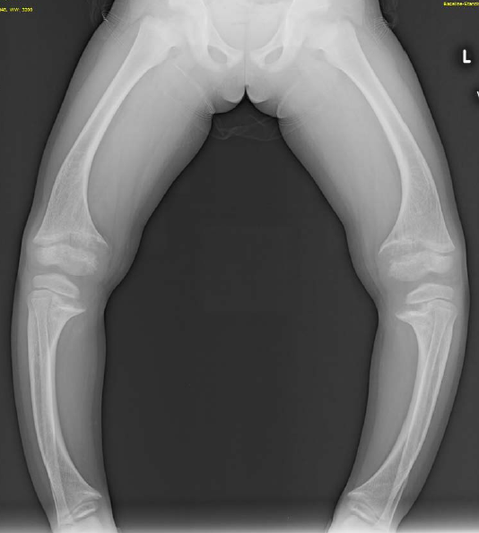
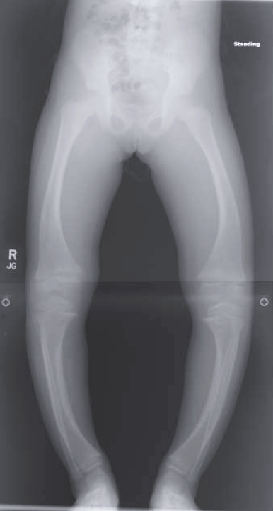
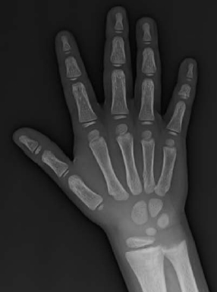
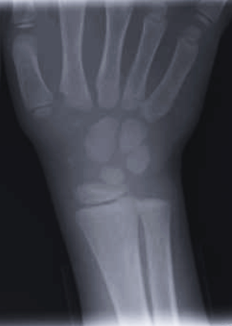
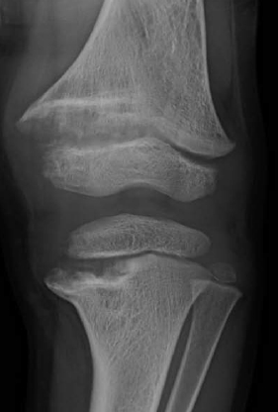
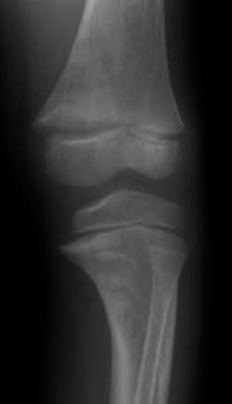
Example of Skeletal Improvement in 4-year-old Girl Treated with Bursoumab
Baseline
Week 64
Baseline
Week 64
Week 64 RGI-C:
Wrist +2.7
Knee +2.0
Global +2.0
Lower Limb deformity +1.7
Imel et al. Lancet 2019;393:2416-2427

Slide 42
The Difference in Height Z-Score Change Between Treatments Was Greater in the Younger Age Group
Z-Score
Difference 0.20
Z-Score Difference 0.09
LS Mean Change from Baseline ± SE
0.00
Baseline
Mean (SE)
-2.27 (0.29)
-2.27 (0.32)
Baseline
Mean (SE)
-1.91 (0.17)
-2.36 (0.32)
Week
Week
n/n
12/13
11/12
12/13
12/13
N/N
20/15
20/15
20/15
20/15
Annualised growth velocity at 64 weeks
Burosumab 6.65 cm
Conventional 5.94 cm
Imel et al. Lancet 2019;393:2416-2427

Slide 43
Function, Pain and Quality of Life (>5 year olds; n=35)
Padidela et al. Calcif Tissue Inter 2021;108:622-633
PROMIS Pain Interference
  Higher scores are a reflection of pain having
  a greater impact on daily activities
6 Minute Walk Test
Significant difference at 40 weeks
Clinically significant improvement at 64 weeks
Greater distance covered
in 6 minute walk test

Slide 44
SF-10 Health Survey for Children
(Caregiver reported Health Related QoL)
Significant Improvement in Physical Health Score
No significant change in Psychosocial Health Score
Padidela et al. Calcif Tissue Inter 2021;108:622-633

Slide 45
Burosumab’s Safety Profile Was Similar to that of Previous Burosumab Paediatric Trials, With Most Adverse Events (AEs) Mild to Moderate in Severity
Assessment | Pi/D (n=32) | Burosumab (n=29)
AEs | 27 (84.4) | 29 (100.0)
Related AE | 7 (21.9) | 17 (58.6)
Serious AE | 3 (9.4) | 3 (10.3)
Serious Related AE | 0 (0.0) | 0 (0.0)
Grade 3 or 4 AE | 3 (9.4) | 4 (13.8)
AEs of Interest
Injection Site AEs | Not applicable | 15 (51.7)
Hypersensitivity AEs | 6 (18.8) | 11 (37.9)
Pyrexia* | 6 (18.8) | 16 (55.2)
Tooth abscess | 3 (9.4) | 8 (27.6)
Hyperphosphatemia | 0 (0) | 0 (0)
Serious AEs – all resolved, unrelated to treatment, and mild-moderate severity, unless noted below
  3 burosumab: craniosynostosis, a viral infection, and a migraine
  3 Pi/D: craniosynostosis (considered severe), bilateral genu varus deformities, and haematuria
No noteworthy changes in serum calcium, urine calcium, plasma parathyroid hormone or nephrocalcinosis score
No noteworthy differences in the safety profile between <5 and ≥5 years-old subjects
Imel et al. Lancet 2019;393:2416-2427

Slide 46
Longer Term Follow-up of Children Treated with Burosumab
Linglart et al. J Clin Endocrinol Metab 2022;107(3):813-824

Slide 47
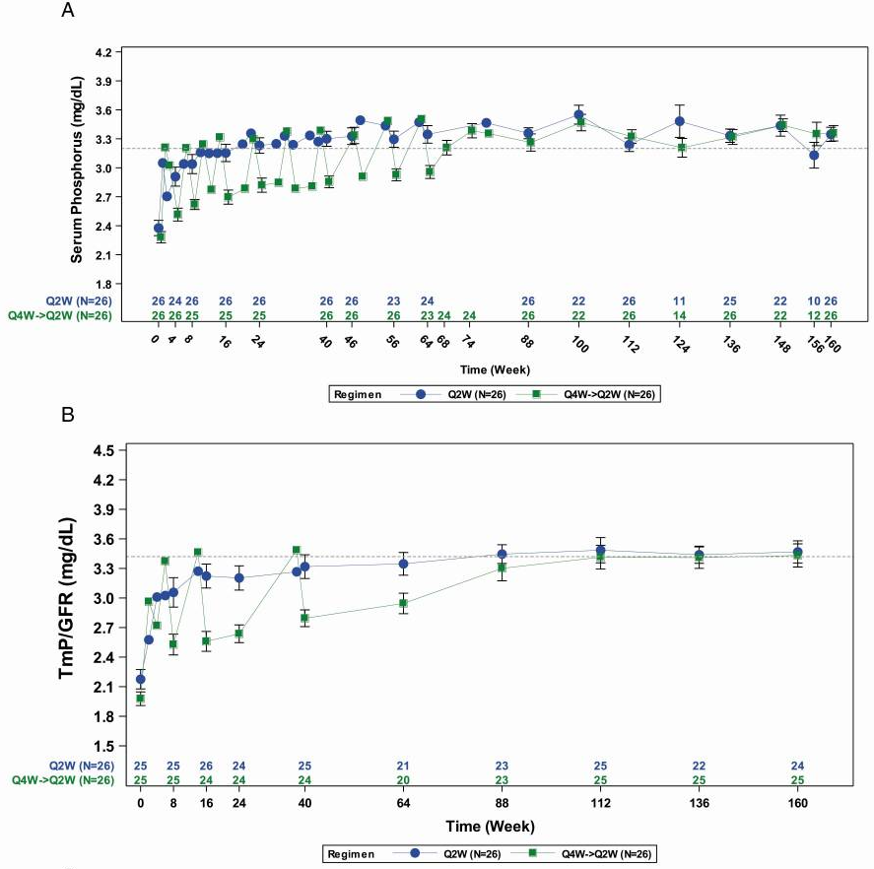
160 week (3 year) follow up
of 26 children with XLH
treated with Burosumab
Persistent beneficial effect
on serum phosphate and
urine phosphate
Linglart et al. J Clin Endocrinol Metab 2022;107(3):813-824

Slide 48
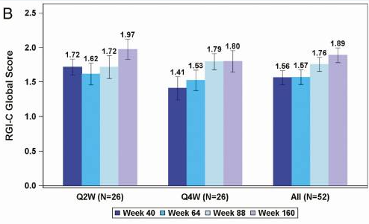
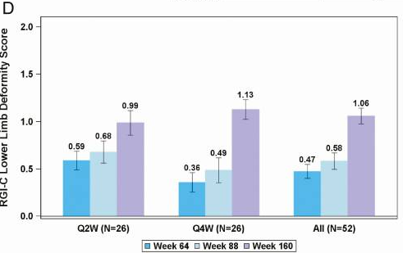
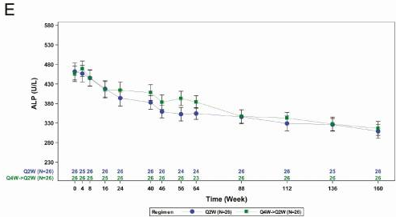
160 week (3 year) follow up
of 26 children with XLH
treated with Burosumab
Persistent beneficial
effect on rickets
(X-rays and ALP)
Linglart et al. J Clin Endocrinol Metab 2022;107(3):813-824

Slide 49
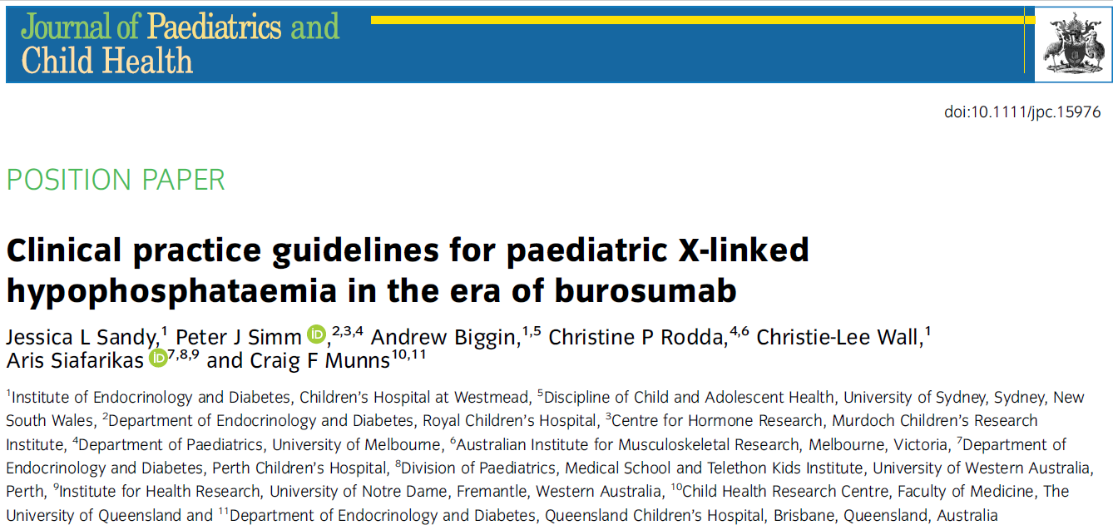
Australasian Paediatric Endocrine Group (APEG)
Bone and Mineral Working Group
Ref: Sandy et. al. (2022), Clinical practice guidelines for paediatric X-linked hypophosphataemia in the era of burosumab. J Paediatr Child Health, 58: 762-768. https://doi.org/10.1111/jpc.15976

Slide 50
Interdisciplinary Team
Endocrinologist
Nephrologists
Paediatrician
Orthopaedic Surgeon
Dental
  Abscess
  Periodontal
Craniofacial
  Craniosynostosis
Neurosurgical
  Chiari malformation
Radiology
Nuclear Medicine
Pharmacist
Physiotherapist
Occupational therapist
Audiology
Psychologist
General Practitioner
Family

Slide 51
Conclusions of CRYSVITA® in Paediatric XLH
CRYSVITA® – FGF23 antibody offers the opportunity for improved outcome
The magnitude of improvement in phosphate homeostasis, rickets, and bowing were consistently greater with CRYSVITA® than conventional therapy in both younger and older children
Sustained benefit at 3 years
CRYSVITA® showed greater improvement in height Z-score compared to Pi/D in younger subjects, suggesting a critical developmental period for intervention
CRYSVITA®
    Improves physical function and Pain Interference
    Improves QoL
There were no concerning safety findings with CRYSVITA®
Interdisciplinary care is essential

Slide 52
Acknowledgements
APEG Bone and Mineral Working Group
  Jessica Sandy
  Christine Rodda
  Peter Simm
  Aris Siafarikas
  Andrew Biggin
  Christie Wall
  USA
  Erik Imel

Slide 53
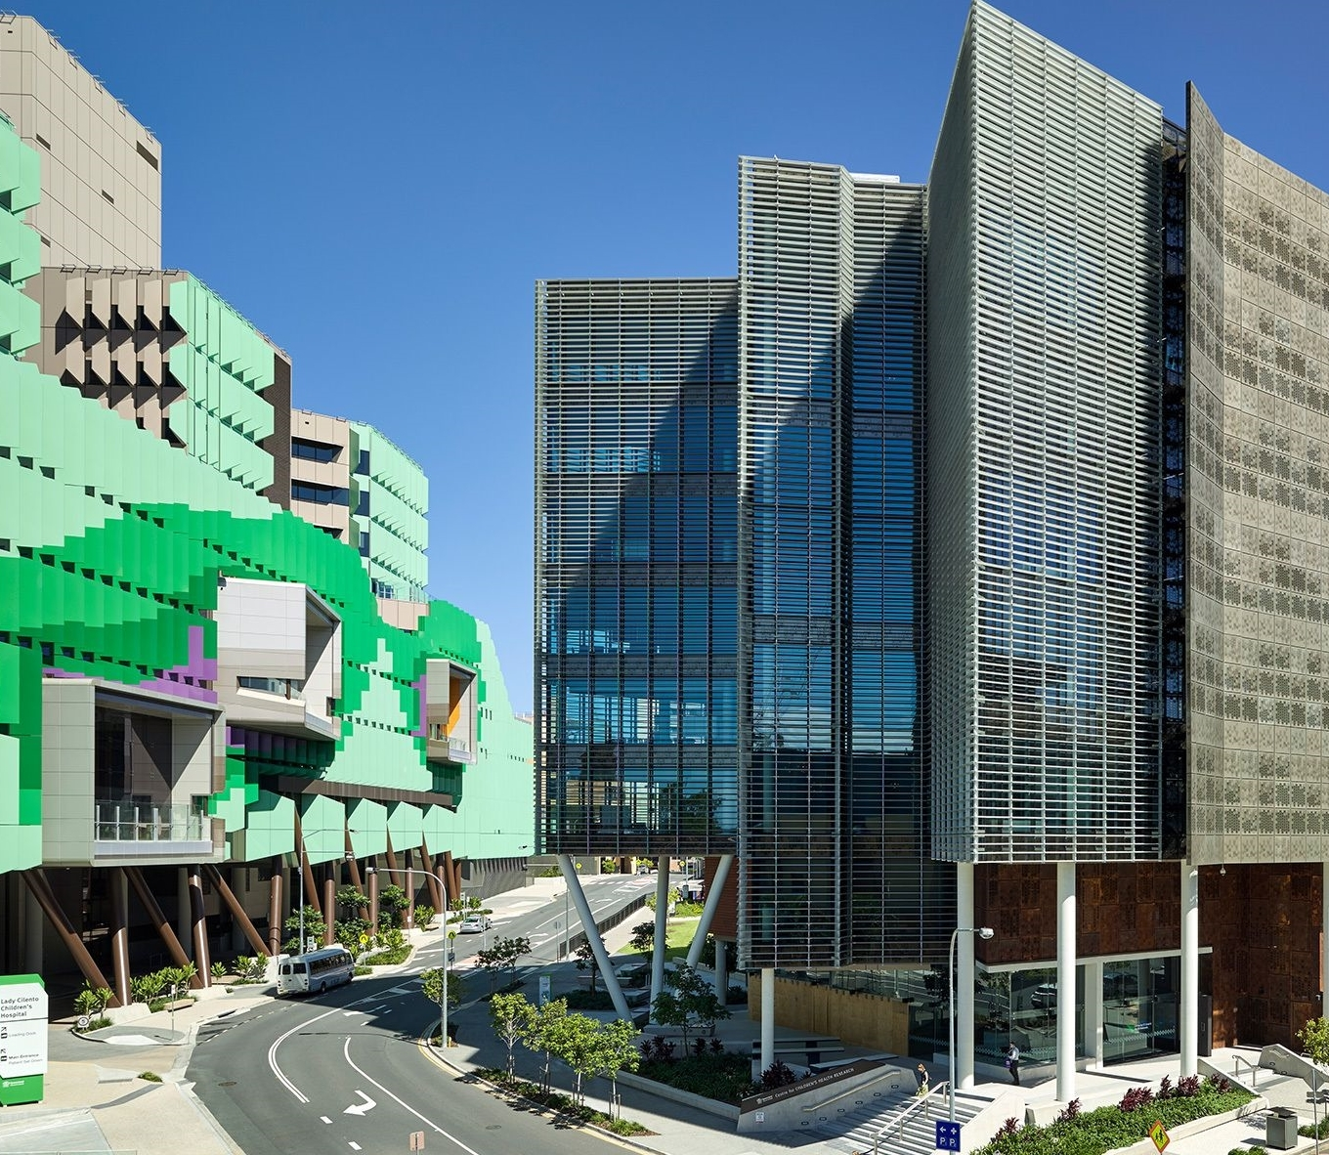

Mayne Academy of Paediatrics and UQ CHRC
Thank You
ANZBMS 2022

Slide 54
Agenda
Time | Topic | Speaker/Chair
Topic 1: Welcome | Welcome
1:40pm | Welcome from the sponsor | Dr Tiffany BAMFORD KKAU Medical Affairs
1:43pm | Introductions & learning objectives from the Chair | Prof Peter EBELING (Chair) Monash Health
Topic 2: X-Linked Hypophosphataemia | Sales onboarding
1:45pm | XLH: Looking back, looking forward | Prof Craig MUNNS (Speaker) Queensland Health
Topic 3: Introducing CRYSVITA® (burosumab) - a new treatment option for XLH | Medical update
1:50pm | The safety and efficacy of CRYSVITA® in paediatrics | Prof Craig MUNNS (Speaker)
1:58p | The safety and efficacy of CRYSVITA® in adults | Dr Syndia LAZARUS (Speaker) Queensland Health
2:06pm | Panel Discussion The practical use of CRYSVITA® in Australia | Prof Peter EBELING (Chair) Prof Craig MUNNS (Panellist) Dr Syndia LAZARUS (Panellist)
2:18pm | Close | Prof Peter EBELING

Slide 55
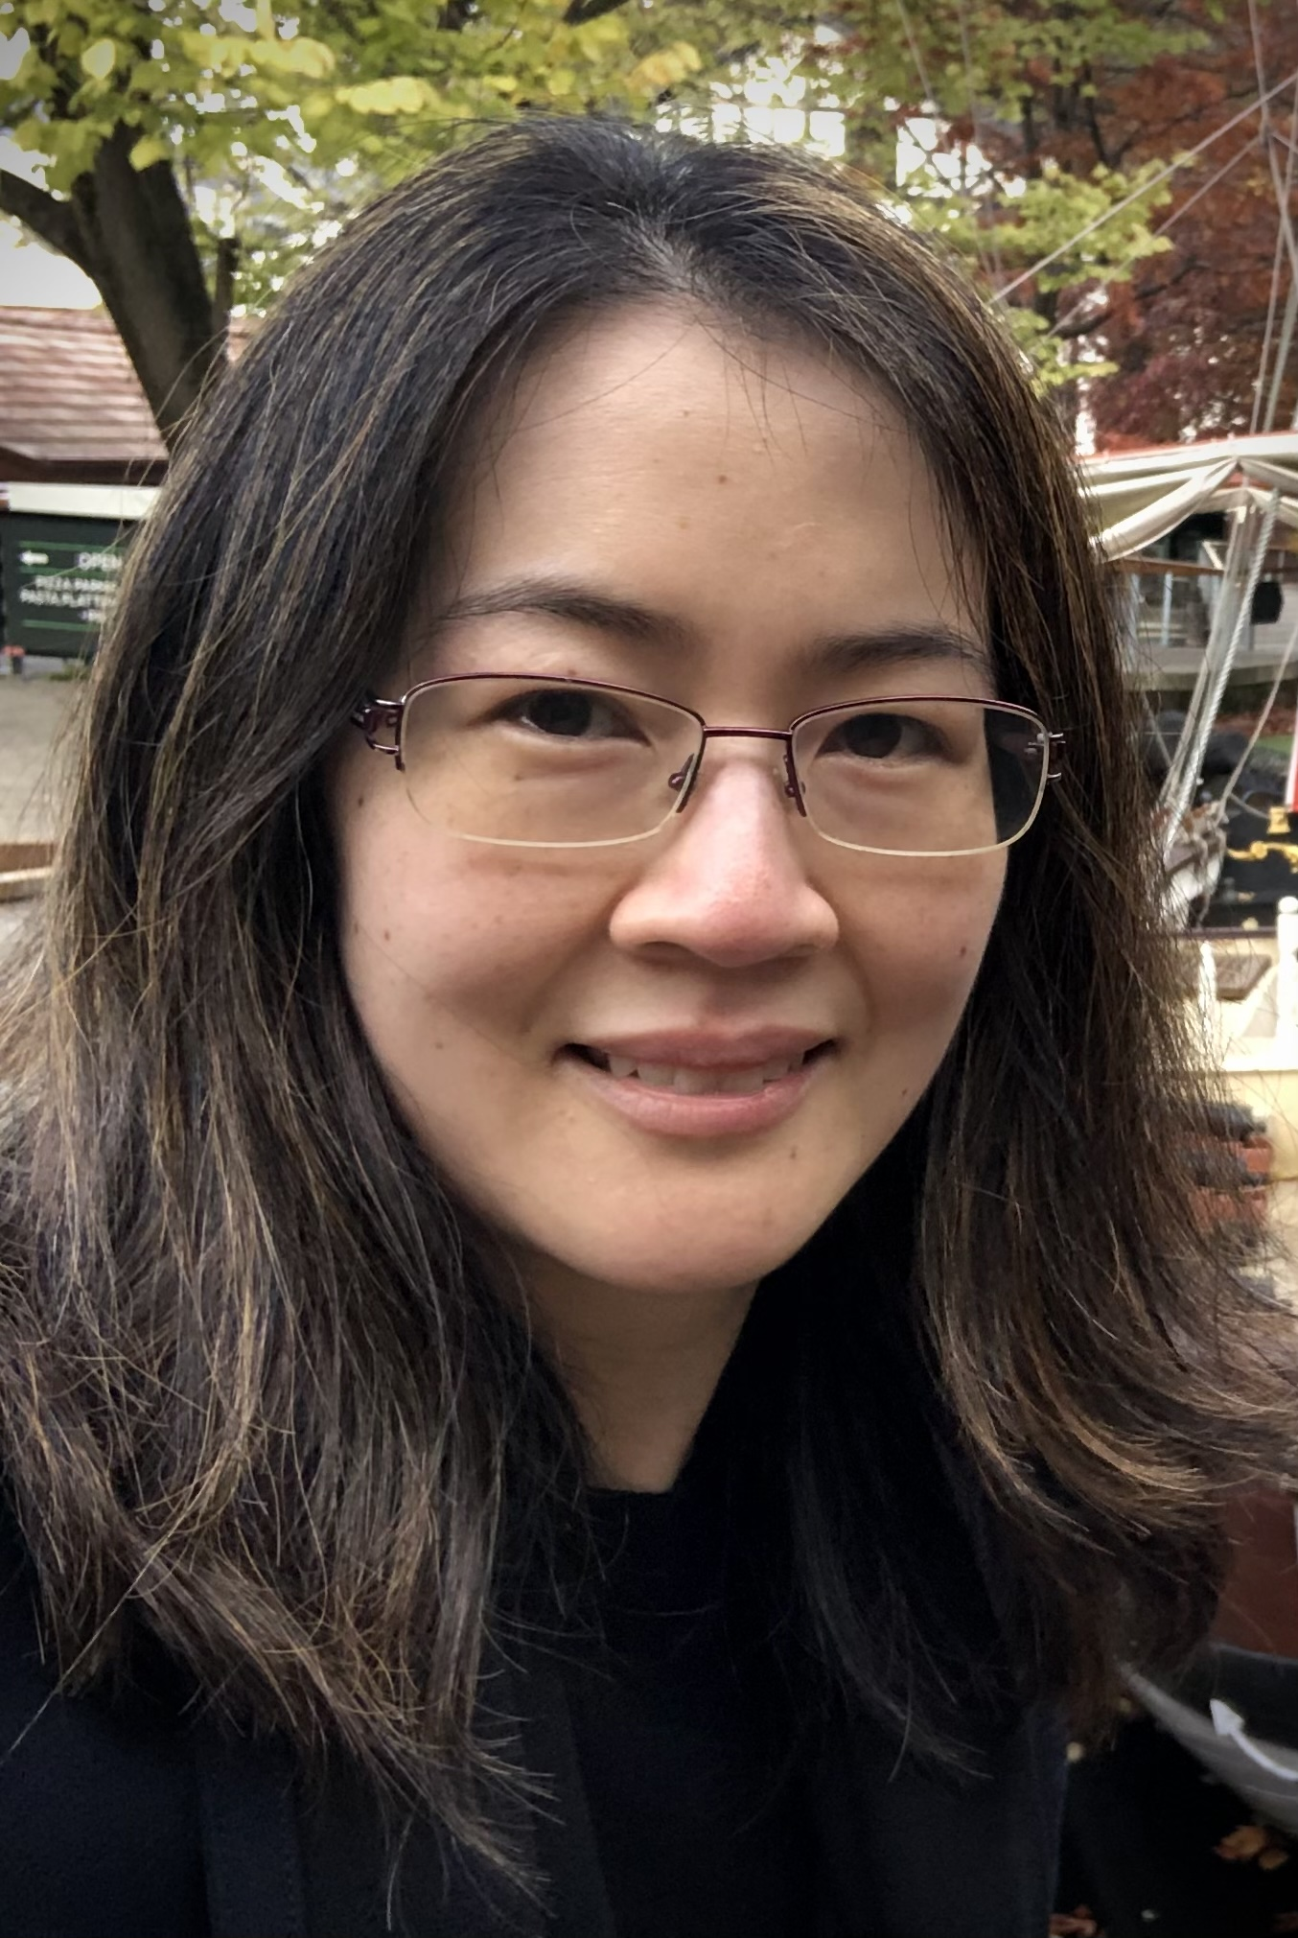
Introducing…
Dr Syndia Lazarus
Senior Staff Specialist
Royal Brisbane and Women’s Hospital
MBBS (Hons I) FRACP PhD

Slide 56
The safety and efficacy of CRYSVITA® in adults
Dr Syndia LAZARUS
Senior Staff Specialist, Endocrinology
Royal Brisbane and Women’s Hospital

Slide 57
General speaker disclaimer
The content presented by each speaker is their own work and has not been influenced by employees of Kyowa Kirin Australia.
Speakers have received an honorarium for the preparation and presentation of their work.
Kyowa Kirin Australia does not expect payment for services to be an inducement for the Speaker to prescribe, supply, administer, recommend, purchase, pay for, reimburse, authorise, approve, sell or supply any product or services of the Company and the Speaker agrees that this this honorarium does not constitute an illegal inducement of any kind.

Slide 58
Disclosures
I have received honoraria from Kyowa Kirin International, Plc. and Amgen

Slide 59
Case – Mr A (32yo)
3yo
Diagnosed with rickets at – treated as vitamin D deficient rickets
14yo
Surgery for genu valgum deformity – recurred
27yo
Persistent proximal myopathy
Bilateral hip, knee and upper arm discomfort R>L for years
Degenerative joint changes
Dental abscesses and previous root canal treatment
Commenced phosphate
1 g/day and calcitriol 0.5 mcg/day
30yo

Slide 60
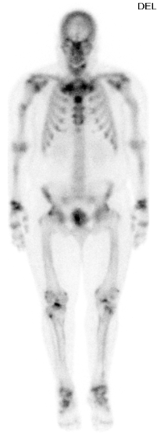
Investigations on conventional therapy
Biochemistry
  PO4 0.58 (0.75-1.50 mmol/L)
  CCa 2.28 (2.10-2.60 mmol/L)
  PTH 6.6 (1.0-7.0 pmol/L)
  ALP 116 (30-110 U/L)
  FGF23 101 (23-95 ng/L)
Bone scintigraphy showed insufficiency fractures of R humerus and R proximal tibia
Referred to Genetic Health Qld for testing and preconception counselling
  Confirmed PHEX mutation
Phosphate/calcitriol poorly tolerated due to GI side effects
Notes:
PO4 – Fasting Serum Phosphate
CCa – Corrected Calcium
PTH – Parathyroid Hormone
ALP – Alkaline Phosphatase
FGF23 – Fibroblast Growth Factor 23
PHEX - phosphate regulating endopeptidase homolog X-linked
GI - Gastrointestinal

Slide 61
Phase III study UX023-CL303 ‒ Study design
7-day
wash-out
Vitamin D metabolites/ analogues, oral phosphate
1 mg/kg* burosumab Q4W
(N=68)
1 mg/kg* burosumab Q4W
(N=67)
Open-label extension
Randomisation (1:1)
Placebo
(N=66)
1 mg/kg* SC burosumab Q4W
(N=66)
Open-label extension
Population
  Ages 18–65 years
  134 adults with XLH
  Serum phosphate and TmP/GFR
  <0.81 mmol/L (2.5 mg/dL)
  BPI Worst Pain score of ≥4
  (scale 0–10)
Week
0
24
48
96
Placebo-controlled treatment period
Treatment
continuation period
Endpoints
Biochemistry: serum phosphate, ALP, TmP/GFR
Bone mineralisation markers
Patient-reported outcomes: BPI Worst Pain score, WOMAC stiffness subscale score, and WOMAC physical function subscale score
Safety
Notes:
Biochemical markers of bone remodelling were:
procollagen type 1 N-propeptide (P1NP),
carboxy-terminal cross-linked telopeptide of type I collagen (CTx), and
bone-specific alkaline phosphatase (BALP).

Slide 62
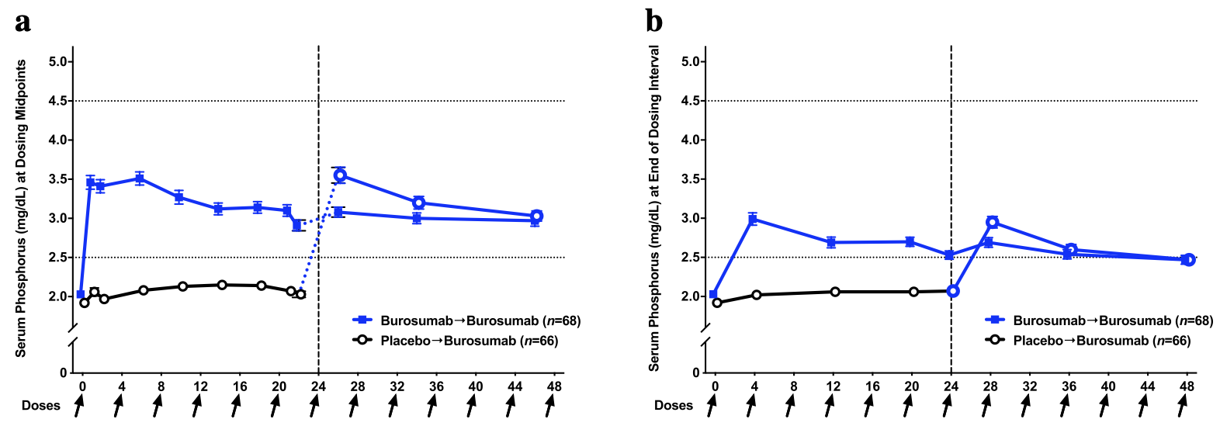
Phosphate homeostasis on Crysvita®
~85% of participants had PO4 within the normal range at 48 weeks
Portale et al 2019 Calcif Tissue Int

Slide 63
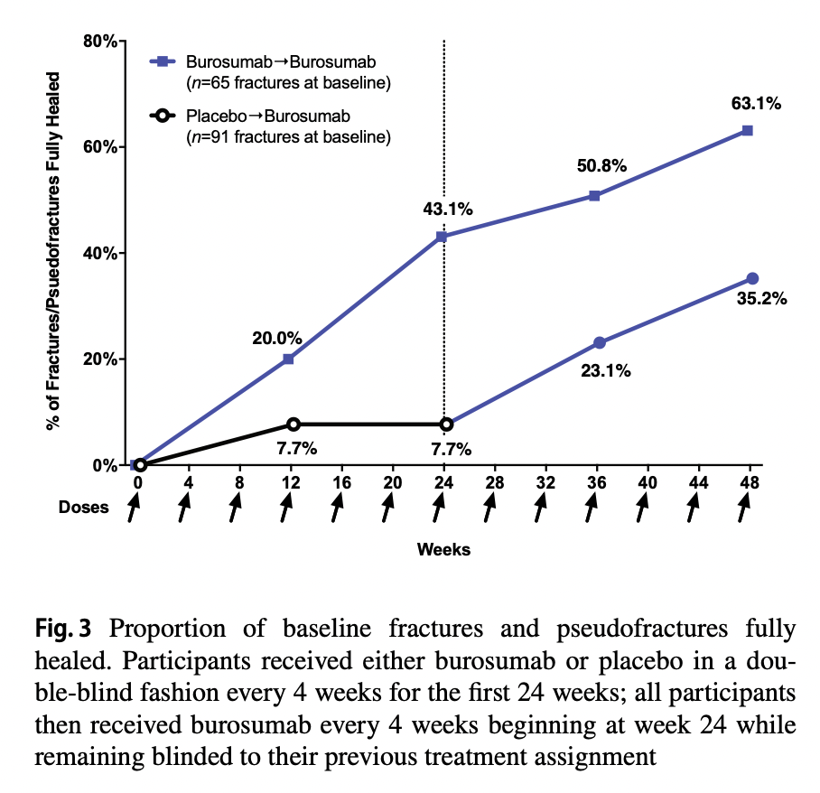
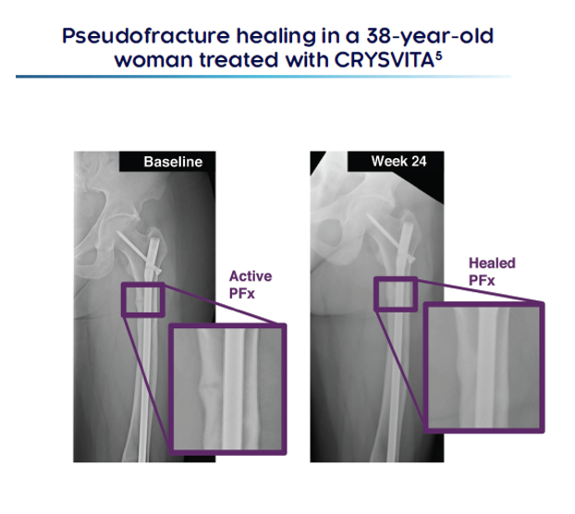
Fracture healing on Crysvita®
80% of participants achieved partial or complete healing after 48 weeks treatment
Portale et al 2019 Calcif Tissue Int

Slide 64
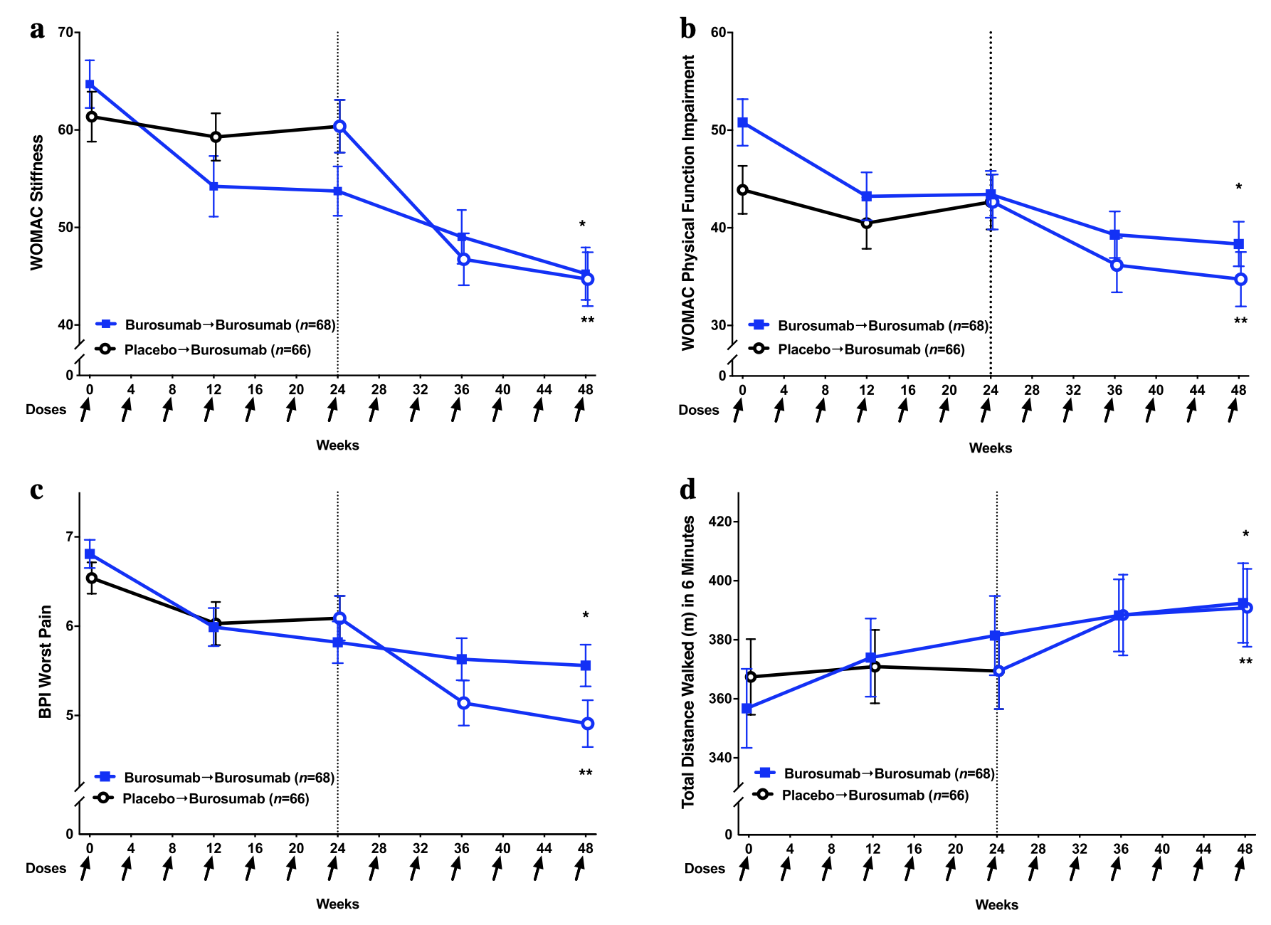
Sustained improvements in stiffness, physical function and pain on Crysvita®
Portale et al 2019 Calcif Tissue Int

Slide 65
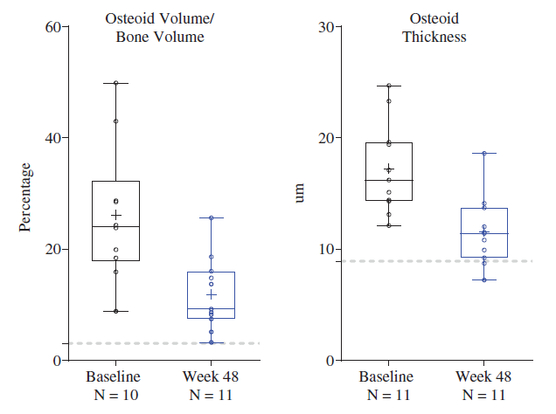
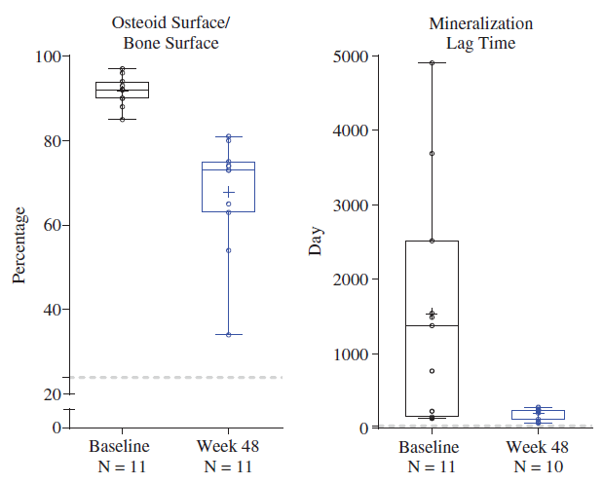
Improvement in bone quality and enhanced bone mineralization on Crysvita®
Data are presented as median, interquartile,range, mean (+), and individual data points (○).
Insogna et al 2019 J Bone Min Res

Slide 66
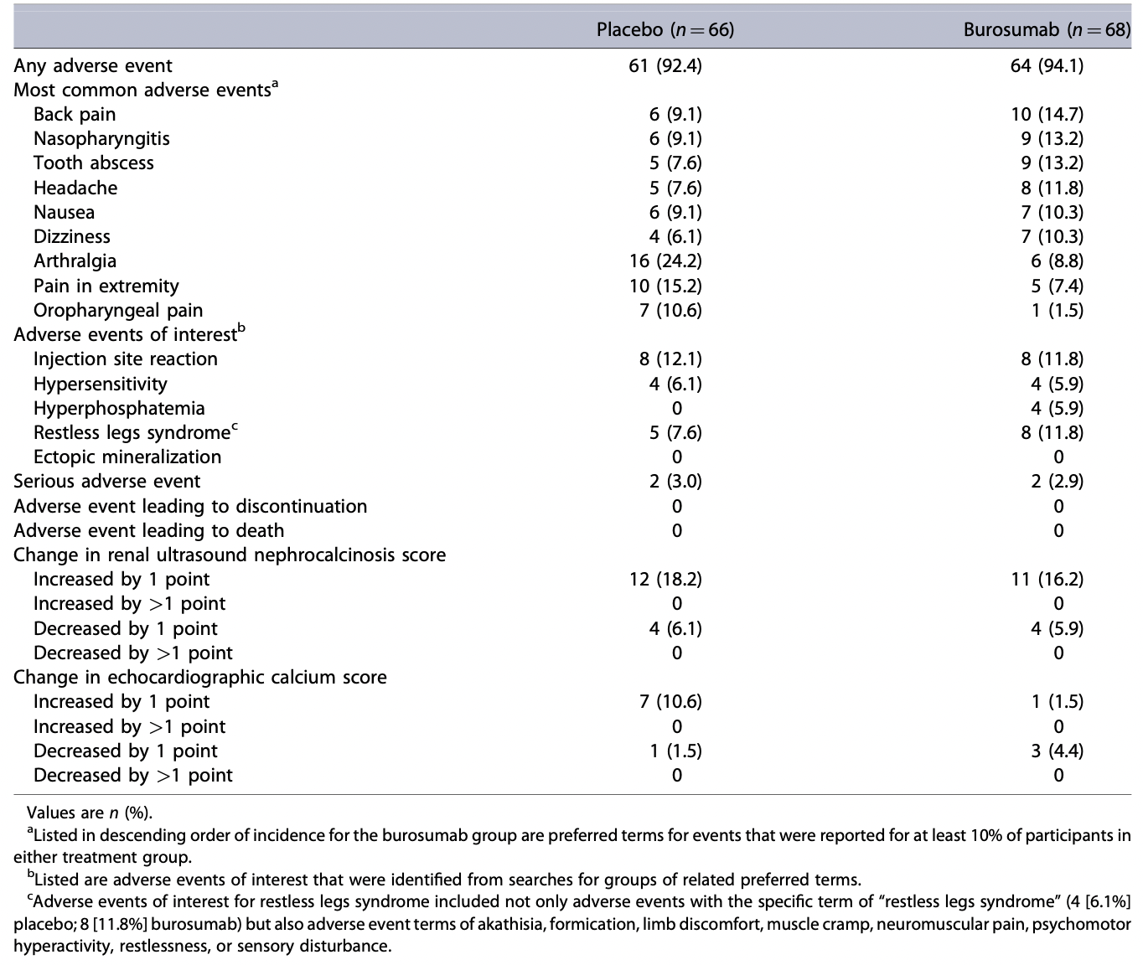
Safety results - 24 wks treatment
Insogna 2018 JBMR

Slide 67
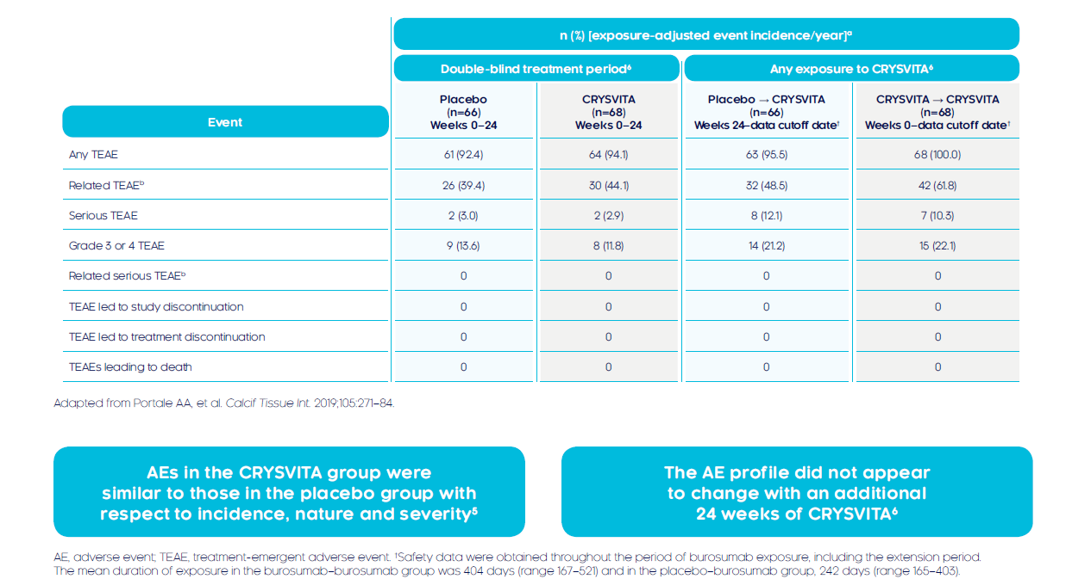
Crysvita® is well tolerated and has an acceptable safety profile up to 48 weeks in adults with XLH
Portale et al 2019 Calcif Tissue Int

Slide 68
Safety results
No new safety concerns relative to those previously observed
Adverse events in the burosumab group were similar to those in the placebo group
The adverse event profile did not appear to change with an additional 24 weeks of burosumab
  Most adverse events were mild to moderate in severity
  No participant stopped burosumab or withdrew from the study
  No treatment-related serious adverse events, deaths, or life-threatening adverse events
Hyperphosphataemia observed in 7% of participants during burosumab treatment
  was without clinical manifestations and resolved after dose reduction
No participant had more than a single grade increase or decrease in nephrocalcinosis score
Serum calcium and PTH concentrations and urine calcium excretion were unchanged with burosumab
Notes:
UX023-CL303 (NCT02526160), safety results
Safety data were obtained throughout the period of burosumab exposure, including the extension period. The mean duration of exposure in the burosumab → burosumab group was 404 days (range 167–521) and in the placebo → burosumab group, 242 days (range 165–403). The incidence, nature, and severity of adverse events were similar between treatment groups.

Slide 69
Summary and conclusions
Efficacy data from the 24-week open-label burosumab treatment continuation period demonstrated that continued exposure to burosumab:
  Led to sustained normalization of phosphate homeostasis
  Progressively increased the proportion of fully healed fractures and pseudofractures
  Improved the key clinical parameters of pain, stiffness and physical function
No new safety concerns relative to those previously observed
  Most adverse events mild to moderate in severity
Despite substantial burden of disease accumulated from a lifetime of XLH, patients experienced clinically meaningful benefits that began shortly after burosumab initiation and persisted with continued administration
Insogna et al 2019 J Bone Min Res
Portale et al. Calcif Tissue Int 2019;105:271.

Slide 70
Agenda
Time | Topic | Speaker/Chair
Topic 1: Welcome | Welcome
1:40pm | Welcome from the sponsor | Dr Tiffany BAMFORD KKAU Medical Affairs
1:43pm | Introductions & learning objectives from the Chair | Prof Peter EBELING (Chair) Monash Health
Topic 2: X-Linked Hypophosphataemia | Sales onboarding
1:45pm | XLH: Looking back, looking forward | Prof Craig MUNNS (Speaker) Queensland Health
Topic 3: Introducing CRYSVITA® (burosumab) - a new treatment option for XLH | Medical update
1:50pm | The safety and efficacy of CRYSVITA® in paediatrics | Prof Craig MUNNS (Speaker)
1:58p | The safety and efficacy of CRYSVITA® in adults | Dr Syndia LAZARUS (Speaker) Queensland Health
2:06pm | Panel Discussion The practical use of CRYSVITA® in Australia | Prof Peter EBELING (Chair) Prof Craig MUNNS (Panellist) Dr Syndia LAZARUS (Panellist)
2:18pm | Close | Prof Peter EBELING

Slide 71
Panel Discussion
The practical use of CRYSVITA® in Australia
Prof Peter EBELING (Chair)
Prof Craig MUNNS (Panellist)
Dr Syndia LAZARUS (Panellist)

Slide 72
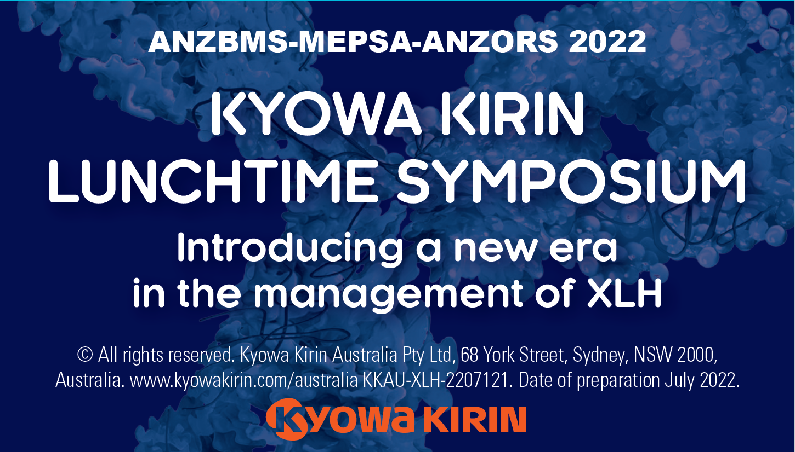

Thank you
USB Cards
For more information on XLH and CRYSVITA® visit the Kyowa Kirin Stand in the Exhibition Hall
© 2022 Kyowa Kirin Limited. All rights reserved. Kyowa Kirin Australia Pty Ltd, 68 York Street, Sydney https://www.kyowakirin.com/australia/index.html Date of Preparation July 2022. Report adverse events to pv.kkau.2r@kyowakirin.com KKAU-XLH-2207274

Slide 73
CRYSVITA® Minimum Product Information
▼This medicinal product is subject to additional monitoring in Australia. This will allow quick identification of new safety information. Healthcare professionals are asked to report any suspected adverse events at www.tga.gov.au/reporting-problems.
MINIMUM PRODUCT INFORMATION CRYSVITA® (burosumab) solution for injection
THERAPEUTIC indication: CRYSVITA® (burosumab) is indicated for the treatment of X-linked hypophosphataemia (XLH) in adults, adolescents and children 1 year of age or older. Dose and ADMINISTRATION: The recommended starting dose regimen for paediatrics (children 1-11yrs and adolescents 12-17yrs) is 0.8 mg/kg of body weight, rounded to the nearest 10 mg, every 2 weeks, up to a maximum dose of 90 mg. The recommended dose regimen in adults (18yrs and older) is 1 mg/kg of body weight, rounded to the nearest 10 mg up to a maximum dose of 90 mg, administered every 4 weeks. Treatment should be initiated and monitored by specialist medical practitioners experienced in the management of patients with metabolic bone disease. Fasting serum phosphate concentration should be below the reference range for age prior to initiation of treatment. CRYSVITA® is administered by subcutaneous injection and should be administered by a healthcare provider. The maximum volume of CRYSVITA® per injection site is 1.5 mL. If multiple injections are required, administer at different injection sites. Contraindications: Hypersensitivity to CRYSVITA® or to any of the excipients. Concurrent administration with oral phosphate and / or active vitamin D analogues. Serum phosphate level within or above the normal range for age at initiation of treatment. Severe renal impairment or end stage renal disease. precautions: Discontinue oral phosphate and active vitamin D analogues at least 1 week prior to initiating CRYSVITA® treatment. Monitor for signs and symptoms of nephrocalcinosis, hyperphosphatemia, ectopic mineralisation, and serious hypersensitivity reactions. Administration should be interrupted in any patient experiencing severe injection site reactions. Discontinue if serious hypersensitivity reaction occurs. Monitoring for signs and symptoms of nephrocalcinosis due to ectopic mineralisation, e.g. by renal ultrasonography, is recommended at the start of treatment and every 6 months for the first 12 months of treatment, and annually thereafter. Monitoring of urine calcium and phosphate is suggested every 3 months. Monitoring of plasma alkaline phosphatase, calcium, parathyroid hormone (PTH) and creatinine is recommended every 6 months (every 3 months for children 1 - 2 years) or as indicated. interactions: Concurrent administration of CRYSVITA® with oral phosphate and active vitamin D analogues is contraindicated as it may cause an increased risk of hyperphosphatemia and hypercalcaemia. Caution should be exercised when combining CRYSVITA® with calcimimetic medicinal products. adverse effects: Very common adverse reactions (>10%) reported in paediatric patients (≥1-17yrs) during clinical trials who had received at least 1 dose of CRYSVITA® were: injection site reactions, cough, headache, pyrexia, pain in extremity, vomiting, tooth abscess, vitamin D decreased, diarrhoea, rash, nausea, constipation, dental caries and myalgia. Common adverse reactions (≤10%) reported in paediatric patients ≥1 year of age during clinical trials who had received at least 1 dose of CRYSVITA® were: dizziness and blood phosphorus increased. Very common adverse reactions (>10%) reported in adult patients (≥18yrs) who had received at least 1 dose of CRYSVITA® during clinical trials were: back pain, headache, tooth infection, restless legs syndrome, muscle spasms, vitamin D decrease and dizziness. Common adverse reactions (≤10%) reported in adult patients who had received at least 1 dose of CRYSVITA® during clinical trials were: constipation and blood phosphorus increased. Content based on full CRYSTVITA® Product Information. Date Approved: 10Sept2021.
Please review full Product Information before prescribing.
Full Product Information is available from the Trade Display or at: https://www.ebs.tga.gov.au/ebs/picmi/picmirepository.nsf/PICMI?OpenForm&t=PI&q=crysvita&r=/
© All rights reserved. Kyowa Kirin Australia Pty Ltd, 68 York Street, Sydney, NSW 2000, Australia. www.kyowakirin.com/australia. enquiry.kkau@kyowakirin.com. KKAU-XLH-2108062. Date of preparation September 2021.

